Slide 1

Digital temperature indicator for transformer using thermal sensors
Group members:
Nazneen (09281A0232)
A.Vishwanath (09281A0233)
G.Sathyanarayana (09281A0235)
Vamshi (09281A0218)

Slide 2
Objectives
As world is becoming digitalization so even transformers should become.
To make work easy for employees working in distribution station.
To implement them in real time.

Slide 3
Features
An Effective Monitor.
Storage and Graphing Capabilities.
Flexible Configurations.

Slide 4
List of components
Regulator(7806-6V)
Temperature sensors(LM35)
ADC(0804LCN)
Microcontroller(AT89C51)
Crystal oscillator(11.0592MHz,3.579MHz)
Resistors(1K,10K,100K)
Diode(IN4007)
LED(5mm)
Capacitors(0.1uf,4.7uf,10uf,33pf)
LCD

Slide 5
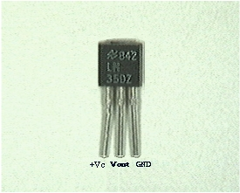
LM35 TEMPERATURE SENSOR
LM35 is a precision IC temperature indicator with its output proportional to the temperature (in ºC). The sensor circuitry is sealed and therefore it is not subjected to oxidation and other processes. With LM35, temperature can be measured more accurately than with a thermistor. It also possess low self heating and does not cause more than 0.1 ºC temperature rise in still air.

Slide 6
FEATURES OF MICROCONTROLLER(AT89S52)
Features:
Quantity:
ROM
8K bytes
RAM
256 bytes
Timer
16 bit
I/O pins
32
Serial port
Duplex type
Interrupt sources
6

Slide 7
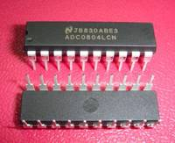
ADC 0804LCN CONVERTER
The ADC0804 are CMOS 8-bit successive approximation A/D converters that use a differential potentiometric ladder-Ð similar to 256R products
This converters are designed to allow operation with the NSC800 and INS8080A derivative control bus with TRI-STATEÉ output latches directly driving the data bus.
These A/Ds appear like memory locations or I/O ports to the microprocessor and no inter-facing logic is needed.

